Slide 1

KNC402
Python Programming
Topic: Recursion

Slide 2
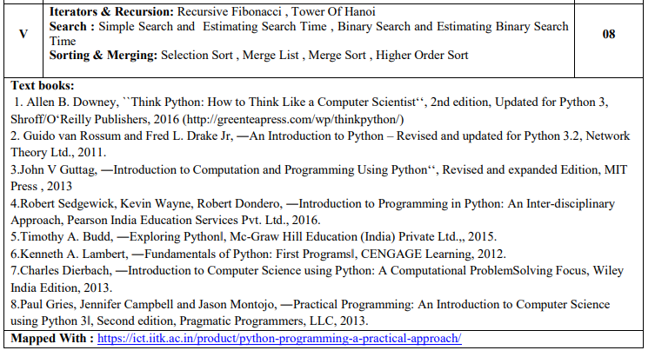
Unit 5

Slide 3
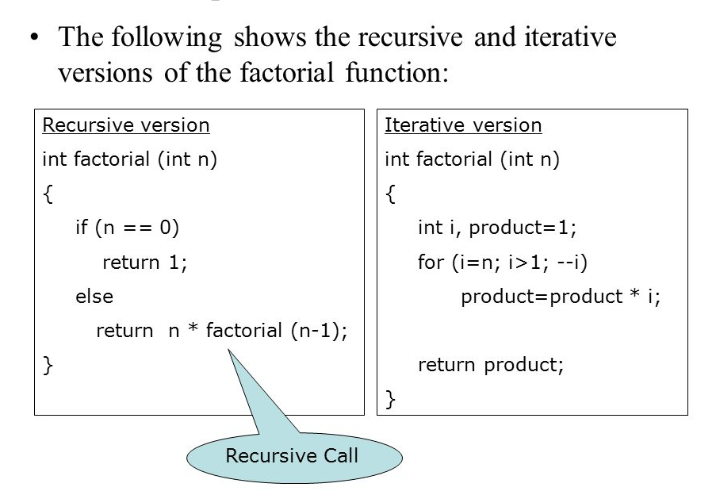
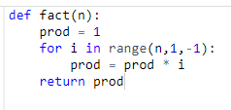
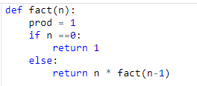
Iterations and recursion

Slide 4
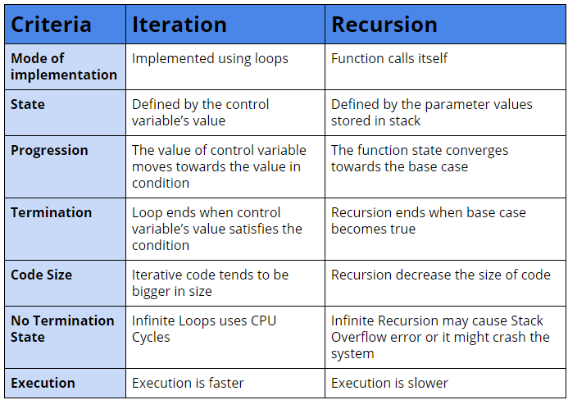
Iterations and recursion

Slide 5
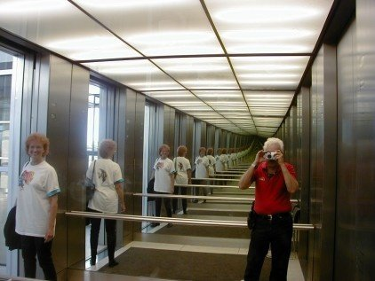

What is recursion?
Recursion is the process of defining something in terms of itself.
A physical world example would be to place two parallel mirrors facing each other. Any object in between them would be reflected recursively.

Slide 6
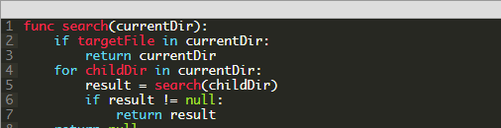
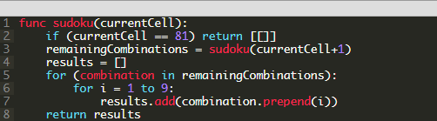
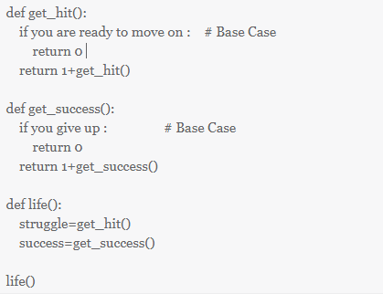
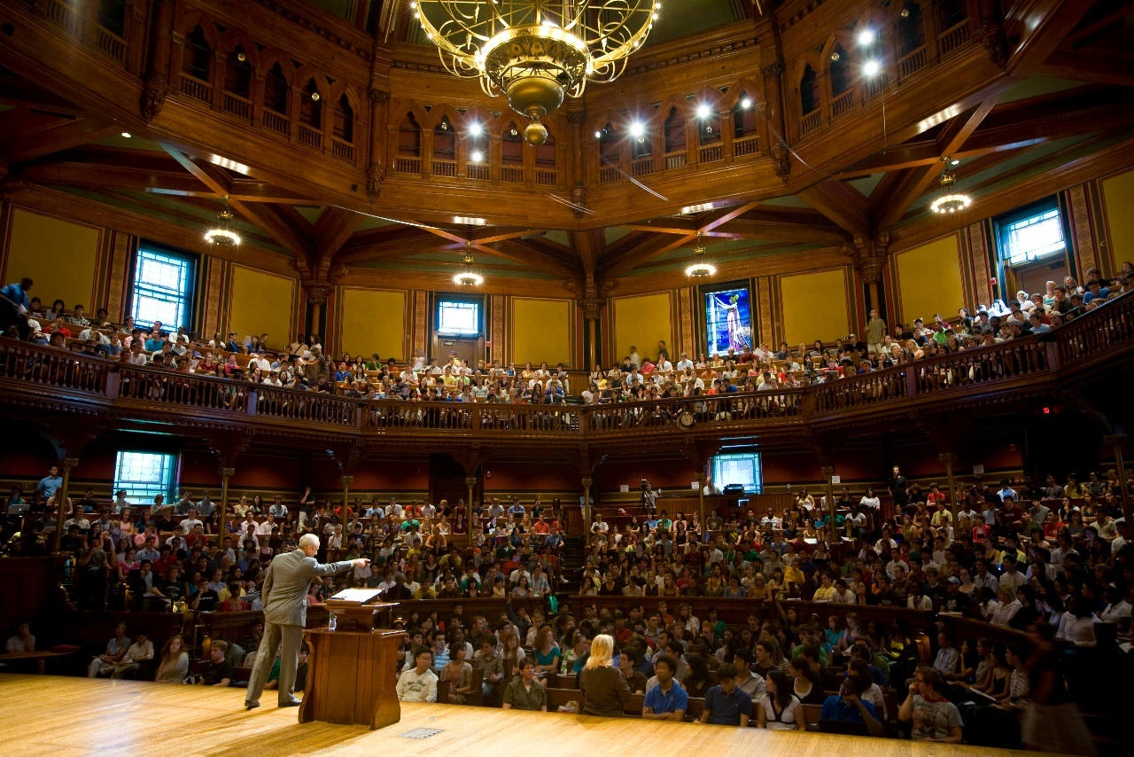
Real Life Examples

Slide 7
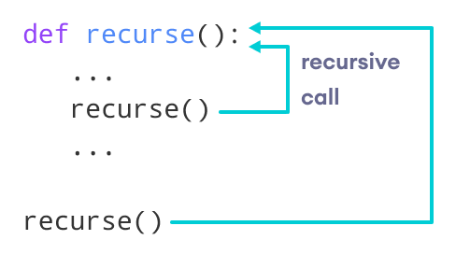
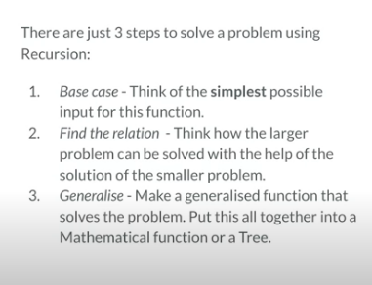
Python Recursive Function
To implement a recursive algorithm, the problem must satisfy the following conditions:
It can be broken down into a simpler version of the same problem
It has one or more base cases whose values are known

Slide 8
Why Use Recursion?
Some situations particularly lend themselves to a self-referential definition
For example, the definition of ancestors.
If you were devising an algorithm to handle such a case programmatically, a recursive solution would likely be cleaner and more concise.

Slide 9
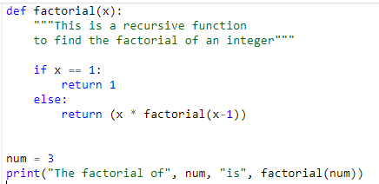

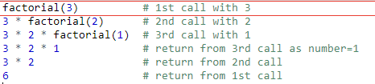
Example of a recursive function
factorial( ) is a
recursive function
as it calls itself.
Output

Slide 10
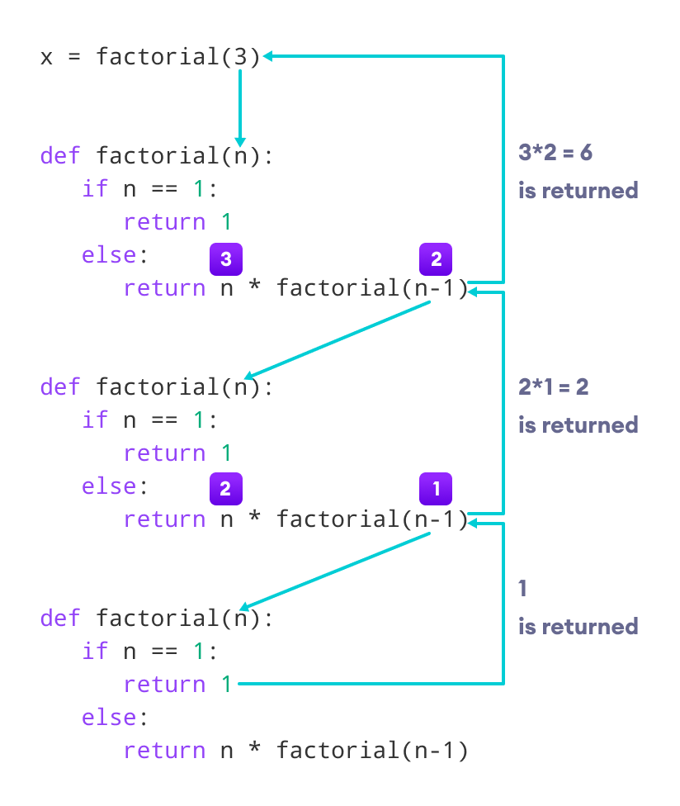
Working of factorial

Slide 11

Advantages of Recursion
Recursive functions make the code look clean and elegant.
A complex task can be broken down into simpler sub-problems using recursion.
Sequence generation is easier with recursion than using some nested iteration.
Disadvantages of Recursion
Sometimes the logic behind recursion is hard to follow through.
Recursive calls are expensive (inefficient) as they take up a lot of memory and time.
Recursive functions are hard to debug.

Slide 12
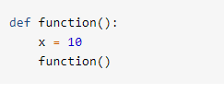
What if recursion is never ending?

Slide 13
Infinite Recursion
When function() executes the first time, Python creates a namespace and assigns x the value 10 in that namespace.
Then function() calls itself recursively.
The second time function() runs, the interpreter creates a second namespace and assigns 10 to x there as well.
These two instances of the name x are distinct from each another and can coexist without clashing because they are in separate namespaces.

Slide 14
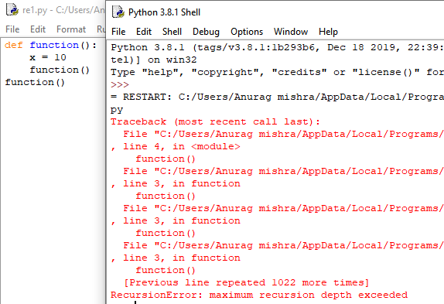

Slide 15
Recursion has some limit???
As written, function() would in theory go on forever, calling itself over and over without any of the calls ever returning.
In practice, of course, nothing is truly forever.
Your computer only has so much memory, and it would run out eventually.
Python doesn’t allow that to happen. The interpreter limits the maximum number of times a function can call itself recursively, and when it reaches that limit, it raises a RecursionError exception, as you see in previous slide.

Slide 16

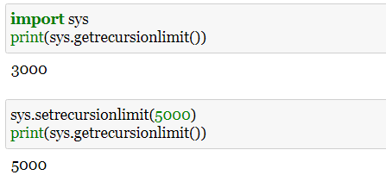
get and set recursionlimit()
Python’s recursion limit is with a function from the sys module called getrecursionlimit():

Slide 17

Speed Comparison of Factorial Implementations
To evaluate execution time, we can use a function called timeit() from a module that is also called timeit.
This function supports a number of different formats, but we will use the following format in this tutorial:

Slide 18
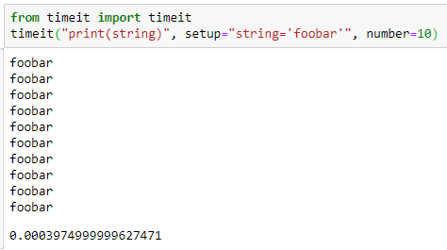
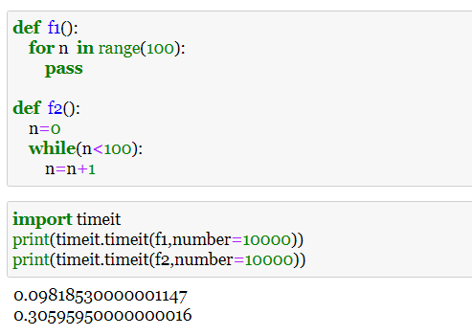
timeit.timeit() function returns the number of seconds it took to execute the code.

Slide 19
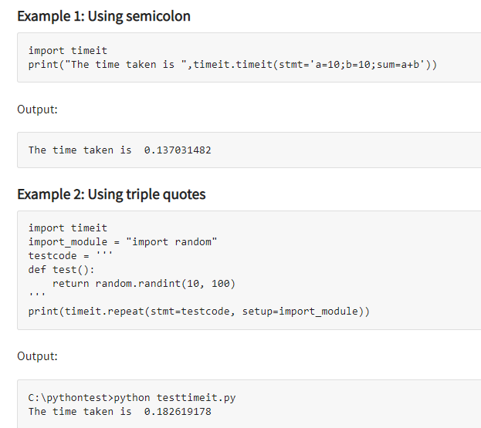
Timeit()
Timeit()is used to get the execution time taken for the small code given

Slide 20
Exercise
Implement factorial using recursion and loop
Then compare time in both the implementations

Slide 21
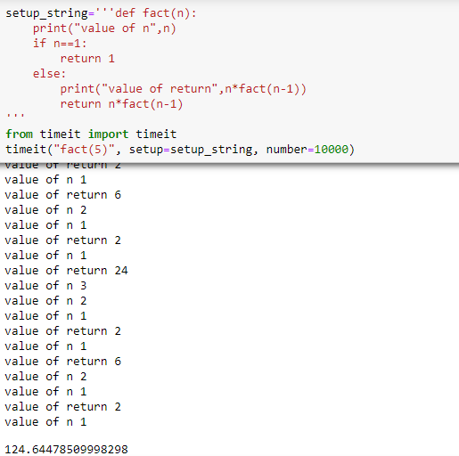
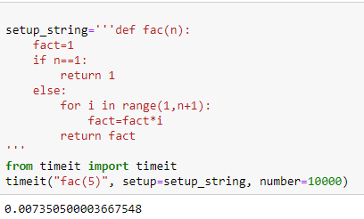

Slide 22
Fibonacci series in python
Fibonacci series in python is a sequence of numbers in which the current term is the sum of the previous two terms.
The first two terms of the Fibonacci sequence are 0 and 1.
So what is the logic behind this?
Let’s understand it in detail.

Slide 23
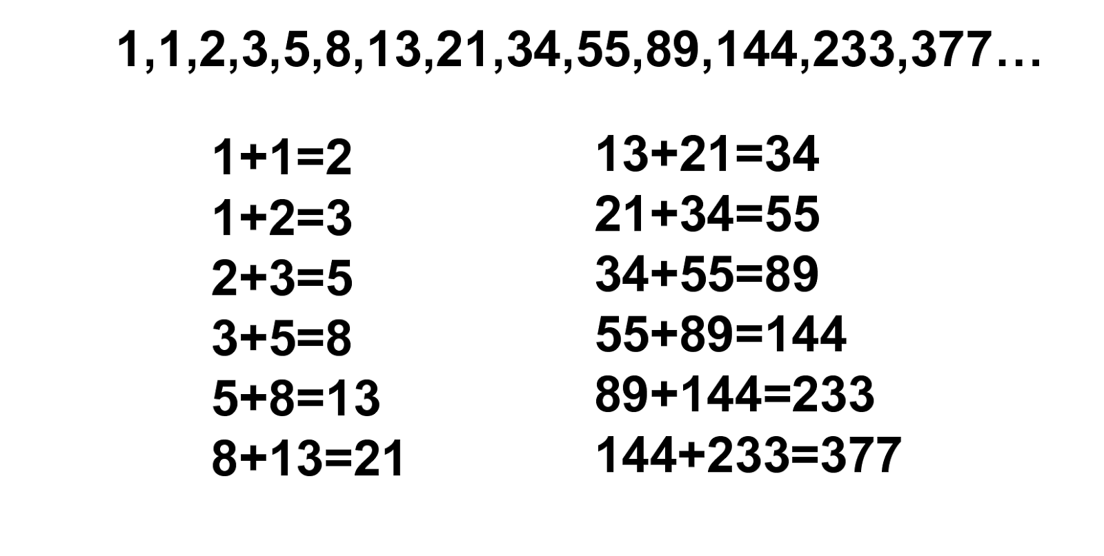
Fibonacci Series

Slide 25
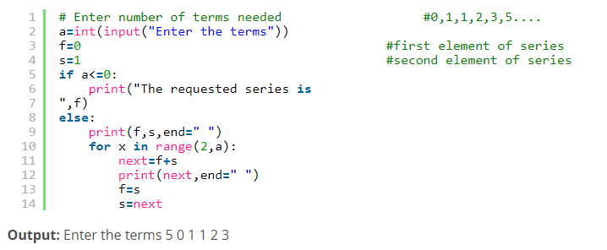
Fibonacci Series using Loop

Slide 26
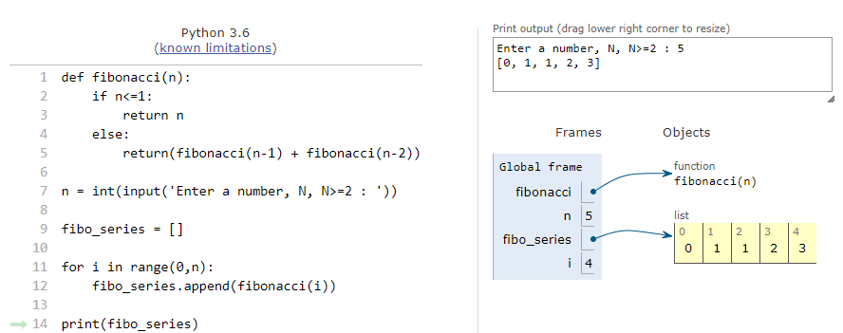
Fibonacci Sequence Using Recursion

Slide 27
Tower of Hanoi
There are three towers
N gold disks, with decreasing sizes, placed on the first tower
You need to move all of the disks from the first tower to the last tower
Larger disks can not be placed on top of smaller disks
The third tower can be used to temporarily hold disks

Slide 28
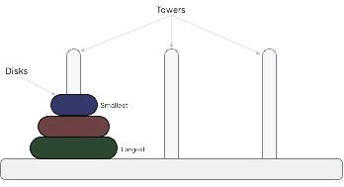
Introduction
Tower of Hanoi is a mathematical game or puzzle.
It was invented by French mathematician Edouard Lucas in1883.
It consists of three rods and a number of disks of different size, which can slide onto any rod.

Slide 29
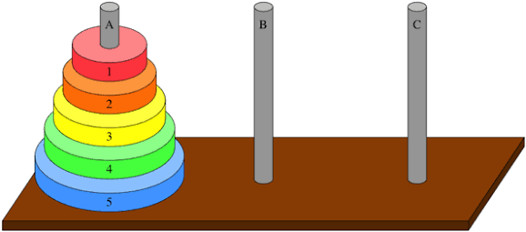
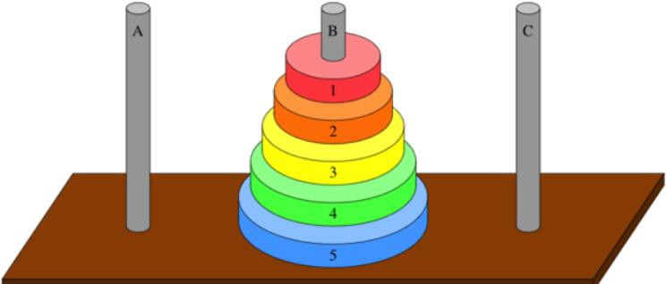
Towers of Hanoi
Initial Position of Tower of Hanoi Puzzle
The Objective of the puzzle is to move the entire stack to another rod.
The Puzzle starts with the disks in a neat stack in ascending order of size on one rod, the smallest on the top, thus making a conical shape.
Final Position of Tower of Hanoi Puzzle

Slide 30
Simple Rules
Only one disk can be moved at a time.
Each move consists of taking the upper disk from one of the stacks and placing it on the top of another stack. A disk can only be moved if it is the uppermost disk on a stack.
No larger disk can be placed on a top of a smaller disk.

Slide 31
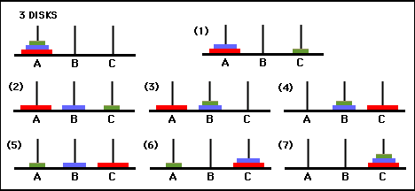
Tower of Hanoi with 3 rods
Goal : Move all Disks from Tower 1 to Tower 3

Slide 32
Algorithm
Step 1: Start the program
Step 2: if disk==1
Step 2.1: Move disk from source to destination
Step 3 : else
Step 3.1 :Move n-1 disks from source to auxiliary rod Step 3.2: Move nth disk from source to destination Step 3.3 : Move n-1 from auxiliary to destination
Step 4: end if
Step 5: stop

Slide 33
Pseudocode
START
IF disk==1, then
move disk from source to destination ELSE
Move n-1 disks from source to auxiliary rod
Move nth disk from source to destination Move n-1 from auxiliary to destination
ENDIF STOP

Slide 34
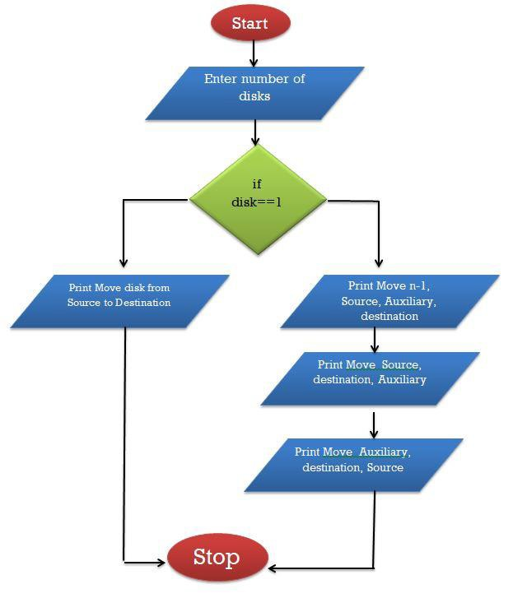
FLOWCHART

Slide 35
Coding
def TowerOfHanoi(n , from_rod, to_rod, aux_rod): if n == 1:
print "Move disk 1 from rod",from_rod,"to rod",to_rod return
TowerOfHanoi(n-1, from_rod, aux_rod, to_rod)
print "Move disk",n,"from rod",from_rod,"to rod",to_rod TowerOfHanoi(n-1, aux_rod, to_rod, from_rod)

Slide 36
Output
Move disk 1 from rod A to rod B Move disk 2 from rod A to rod C Move disk 1 from rod B to rod C Move disk 3 from rod A to rod B Move disk 1 from rod C to rod A Move disk 2 from rod C to rod B Move disk 1 from rod A to rod B Move disk 4 from rod A to rod C Move disk 1 from rod B to rod C Move disk 2 from rod B to rod A Move disk 1 from rod C to rod A Move disk 3 from rod B to rod C Move disk 1 from rod A to rod B Move disk 2 from rod A to rod C Move disk 1 from rod B to rod C

Slide 37
How many moves will it take to transfer n disks from the left post to the right post?
The recursive pattern can help us generate more numbers to find an explicit (non-recursive) pattern. Here's how to find the number of moves needed to transfer larger numbers of disks from post A to post C, remembering that M = the number of moves needed to transfer n-1 disks from post A to post C:
• for 1 disk it takes 1 move to transfer 1 disk from post A to post C;
• for 2 disks, it will take 3 moves: 2M + 1 = 2(1) + 1 = 3
• for 3 disks, it will take 7 moves: 2M + 1 = 2(3) + 1 = 7
• for 4 disks, it will take 15 moves: 2M + 1 = 2(7) + 1 = 15
• for 5 disks, it will take 31 moves: 2M + 1 = 2(15) + 1 = 31
• for 6 disks... ?

Slide 38
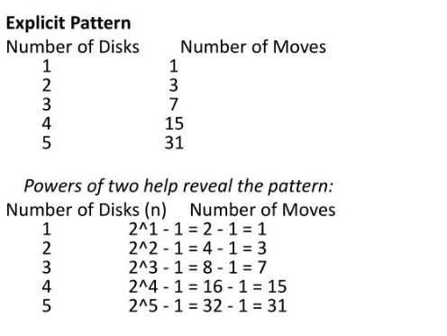
Pattern

Slide 39
Recursive Solution using Animation

Slide 40
Recursive Solution

Slide 41
Recursive Solution

Slide 42
Recursive Solution

Slide 43
Tower of Hanoi

Slide 44
Tower of Hanoi

Slide 45
Tower of Hanoi

Slide 46
Tower of Hanoi

Slide 47
Tower of Hanoi

Slide 48
Tower of Hanoi

Slide 49
Tower of Hanoi

Slide 50
Tower of Hanoi

